Slide 1

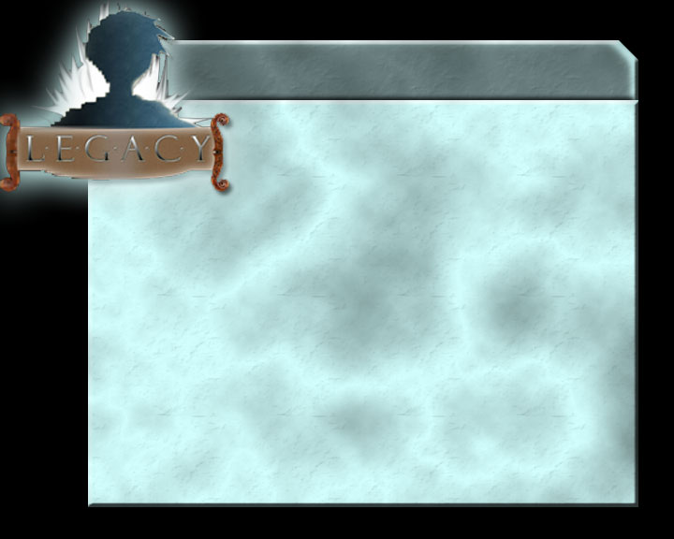

Slide 2
Creators
Henry Birdseye
Angela Burchard
Allison Dugan
Ryan Henyard
Robert Tanniru

Slide 3
Philosophy
Retro games vs. “cutting edge” games
The “legacy” of the platformer genre
Purpose of game creation

Slide 4
General Game Information
Genre
Main Focus
What’s different about it
Audience

Slide 5
Feature Set
General Features
Character Editor
Gameplay

Slide 6
Game Details
Overview
  Trapped inside the consoles
Story
  MVGS vs “old school” games
Victory Conditions
  Boss at end of each world
  Final battle with MVGS

Slide 7
Camera
Overview
  Side scrolling in 8 and 16-bit worlds
  Overhead 3D in 64 and 128-bit worlds
Cut scenes (64-bit/128-bit)
First Person View

Slide 8
Game World
Physical world
  Travel
    Towards objective (boss in landmark)
    Left/right/up/down
    Three dimensional
Time within game world
  No ‘clocks,’ but (hopefully) increasing sense of urgency

Slide 9
World Layout
Worlds
  Four worlds
    8-, 16-, 64-, and 128-bit
Stages
  Follow familiar Forest, Glacier, Plains, Desert pattern
End game
-electronic, non logical, dark

Slide 10

Game Environment

Slide 11
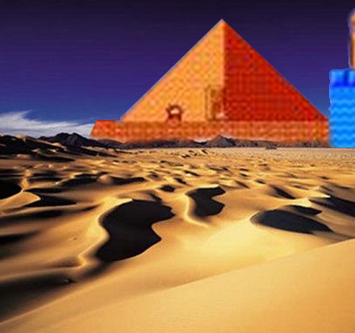
Game Environment

Slide 12
Characters
Creating a character
Hero and sidekick
Enemies and monsters

Slide 13
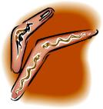
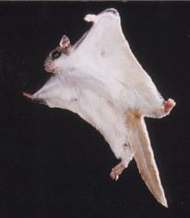
Abilities and Power-ups
World 1
  Jumping – innate, basic attack
  Boomerang – can throw boomerang
  Slide-kick – when running, can slide to kill enemies
World 2
  Squirrel side-kick
    Can feed it powerups to gain powerful, short-term abilities
    Winged nut – only works with squirrel
    Boomerang – Squirrel shoots in front of and behind (around) Alex

Slide 14
More Abilities and Power-ups
World 3
  Slide-kick – becomes innate
  Super-spin – become invincible, move to knock enemies unconcious
World 4
  Shadow Bomb – balls of shadow!
  Thunder Clap – destroys enemies in line of site or around you in a radius

Slide 15
Musical Scores and Sound Effects
Main musical theme upgrades as the player progresses
Sound effects also change over time

Slide 16
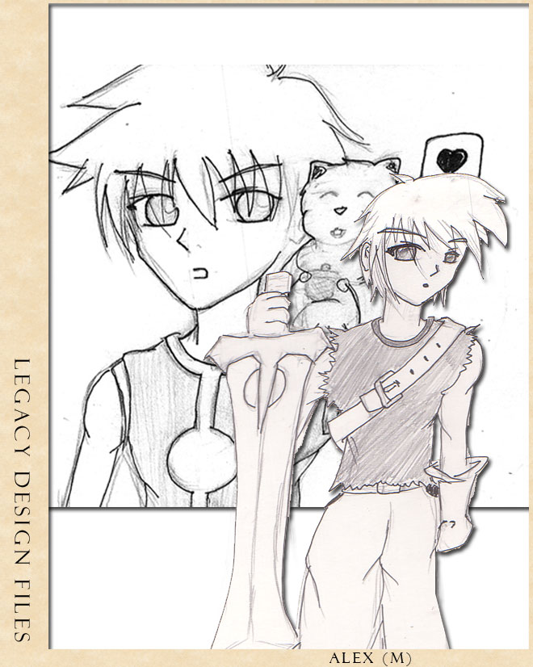
Concept Art

Slide 17
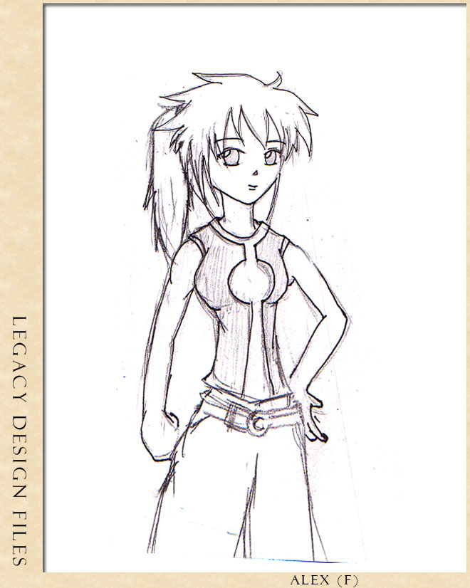
Concept Art

Slide 18
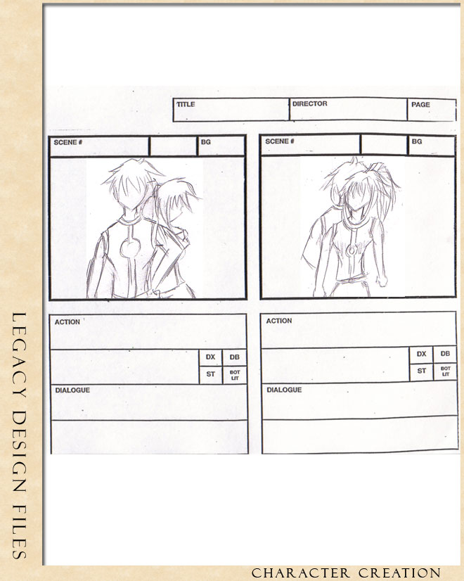
Concept Art

Slide 19
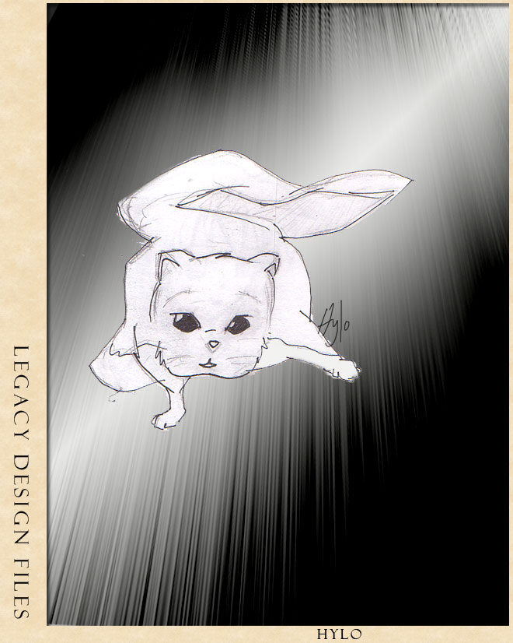
Concept Art

Slide 20
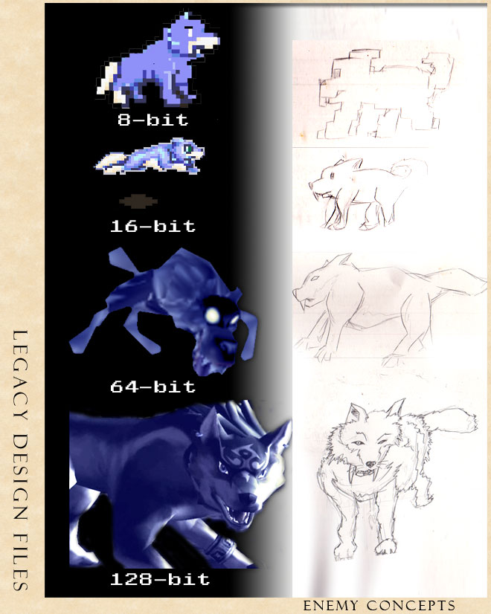
Concept Art

Slide 21
Conclusion

Slide 22
Questions?

Slide 23


